Slide 1
Agro Insurance and Natural Disasters Peggy Sharon, Adv. Levitan, Sharon & Co., Israel
AIDA Morocco
Conference,
Marrakech
23 - 25 April 2019

Slide 2
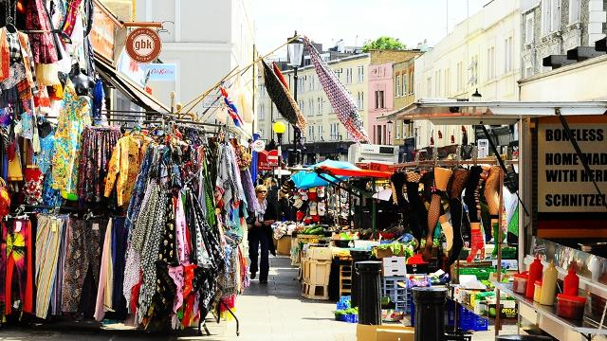
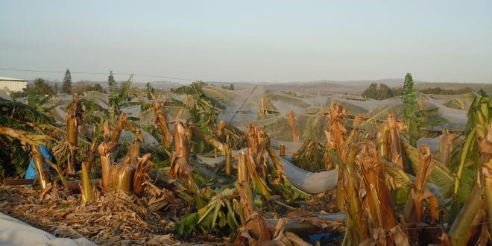
Risks in Agriculture
Risks and uncertainty are inherent in agriculture:
Agriculture as a business, depends highly on an unreliable factors - The Weather and Market Prices.

Slide 3
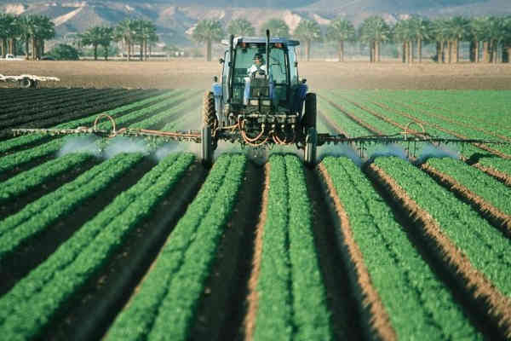
Risks in Agriculture (CONT.)
Agriculture production requires high investments combined with high Risks Exposure makes Risk management (Insurance) a major policy issue in agriculture business.

Slide 4
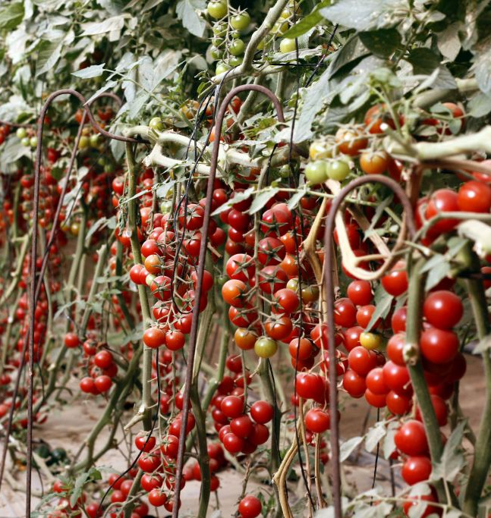
Natural Disasters vs. Natural Damage
Israel:
Natural Disasters: wide spread catastrophes
Government declaration
Natural Disasters Law: infrastructure damage compensation
Natural Damage: unusual climatic damage
Less exceptional than natural disasters
Risk defined in the policy
KANAT - Israeli Insurance Fund for Natural Risks in Agriculture
Insures both natural disasters and natural damage under policies

Slide 5
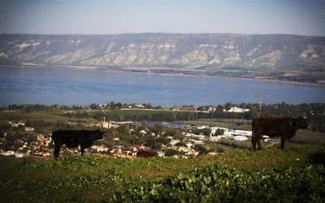
Natural Disasters vs. Natural Damage (cont.)
HCJ 3627/92 Fruit Growers Organization v. The Israeli Government
Not only one major climatic event – irregular accumulation
HCJ 5062/97 Insurance Appraisers Union v. The State of Israel
In the absence of a declaration of a national disaster – lower compensation
RCA 1015/01 Ben Artzi Yakov v. The State of Israel
Real value, not only nominal

Slide 6
Risk Distribution (2006-2015)

Slide 7
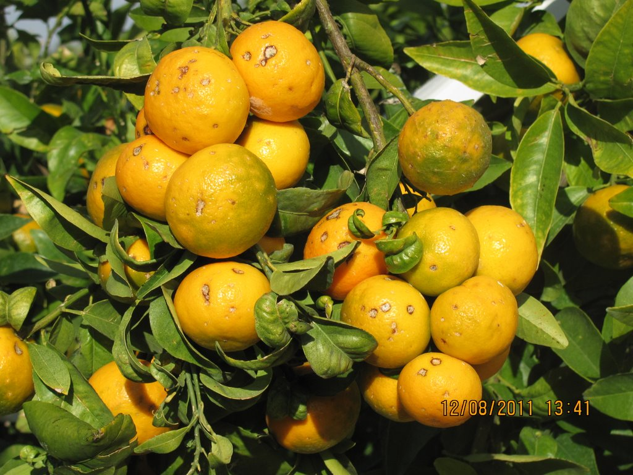
Hail (citrus 2012)
Frost (pepper 2012)

Slide 8
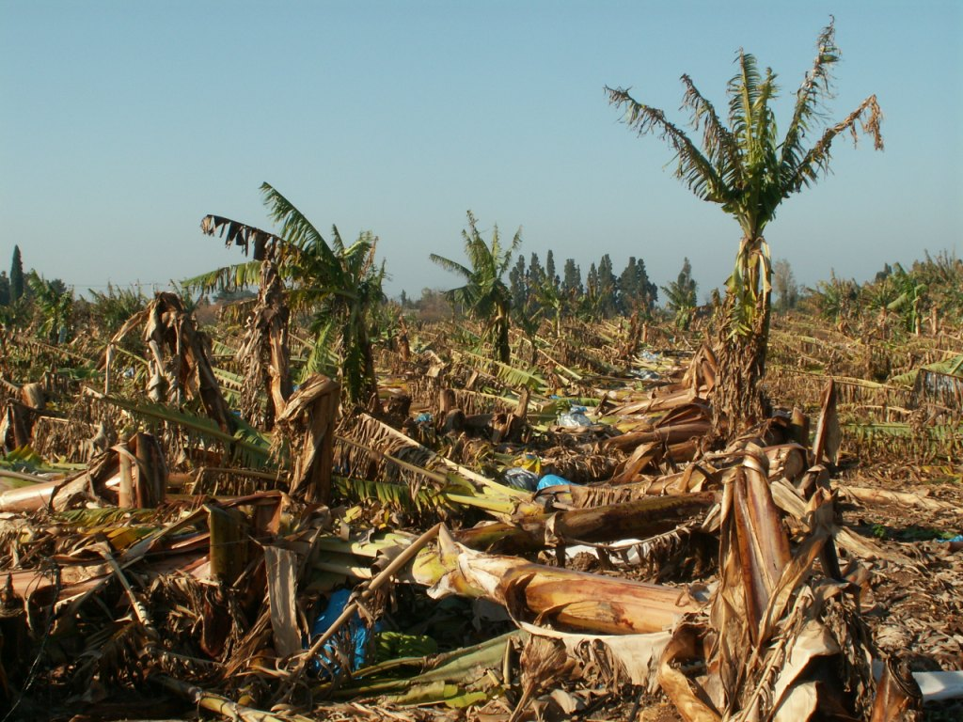
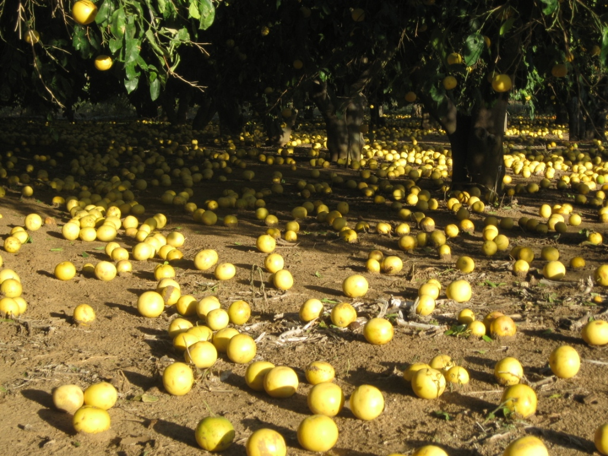
Storm (banana 2013)
Storm (citrus 2013)

Slide 9
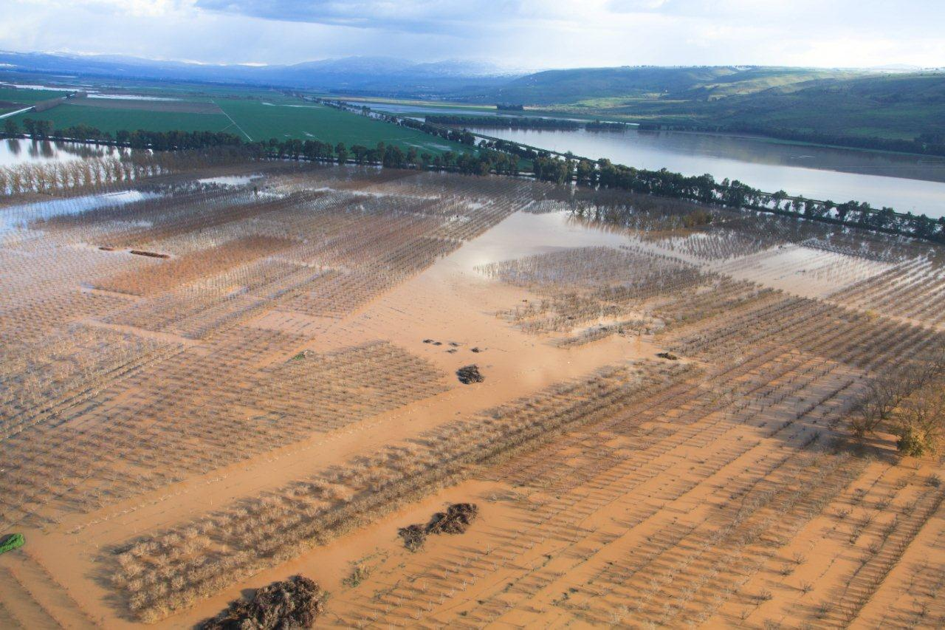
Floods, Hula Valley 2013

Slide 10
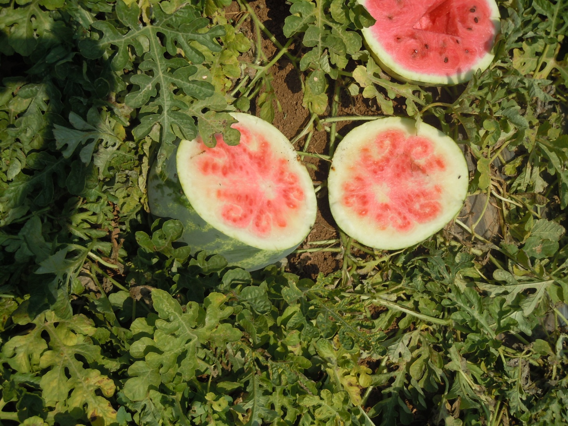
Rain (groundnuts)
Virus (watermelon 2012)

Slide 11
Risk management in agriculture
Types of risks:
Price risks - volatility – imabalance between demand and supply
Production risks – yield lower than expected due to extreme climatic change
Income risks – revenue and cost – unfavorable fluctuations in price

Slide 12
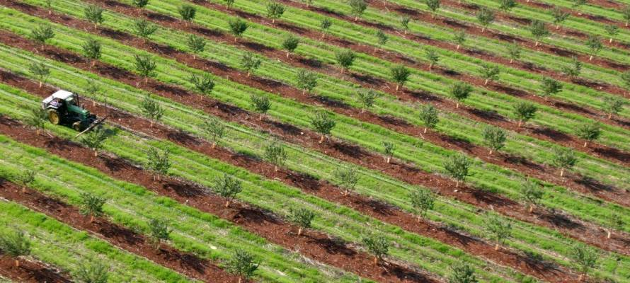
Risk management in agriculture (cont.)
Responses to risks:
Normal risks – managed on farm
Marketable/insurable risks – transfer of risk to private market instruments or sharing with other farmers
Catastrophic/wide spread risks – large scale drought or floods – public/state aid

Slide 13
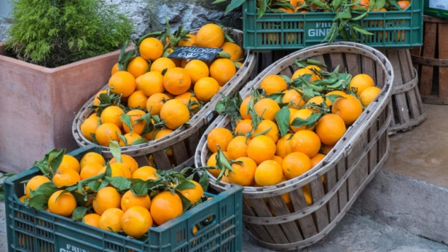
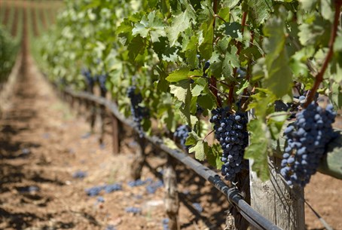
Eu: AGRO Risk schemes
Private risk management: non-subsidized insurance and mutual funds
Public-Private partnerships: state-subsidized insurance and mutual funds
Public instruments: direct payments, market safety net, state aid, reduced tax rates

Slide 14
Innovation – paying benefits on a pre determined Index

Slide 15
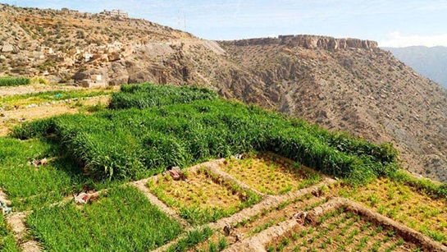
AGRO insurance in morocco
Moroccan gov‘t to launch index-based insurance experiment (April 2017)

Slide 16
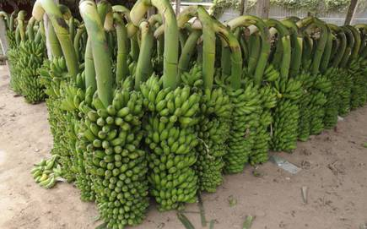
india
Prime Minister Crop Insurance Scheme (PMFBY) – Modi Scheme;
Revised Weather based insurance scheme
Multi-peril Yield insurance (MPCI)
Based on the area-yield index

Slide 17
CHINA
Government Subsidized Agriculture Insurance
Multi-peril Yield insurance (MPCI)
Based on the farm-level yield

Slide 18
Israel: Agricultural INSURANCE
In the Past (until 2000) The government compensated farmers for uninsured damages caused by Natural Disasters as part of the Natural Disaster Law.
Today the government manages it’s agriculture risks by participating in the farmers premiums and supporting KANAT’S insurance programs*.

Slide 19
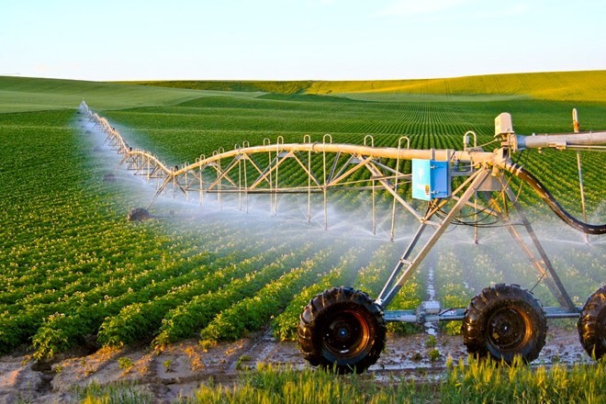
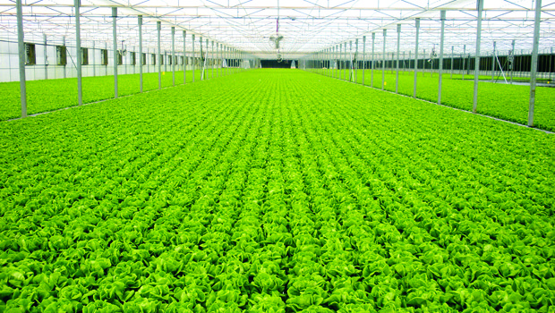
Israel: Agricultural INSURANCE (cont.)
KANAT – The Insurance Fund for Natural Risks in Agriculture
KANAT was founded in 1967 as a government company.
KANAT ownership is held equally by The Government of Israel and 14 different Farmers Marketing Boards and Organizations.
KANAT insures most of the Israeli crops and livestock.
The government participates in the farmers premiums and supports KANAT’S reinsurance programs.

Slide 20
Kanat: insured risks
NDI (Natural Disasters Insuance): | MPCI (Multiple Peril Crop Insurance):
Damage caused by adverse weather conditions which are not covered under MPCI, pests, diseases and defined natural risks to the trees | And more | Hail
 |  | Frost
 |  | Storms
 |  | Floods
 |  | Snow
 |  | Heat waves
 |  | Rain

Slide 21
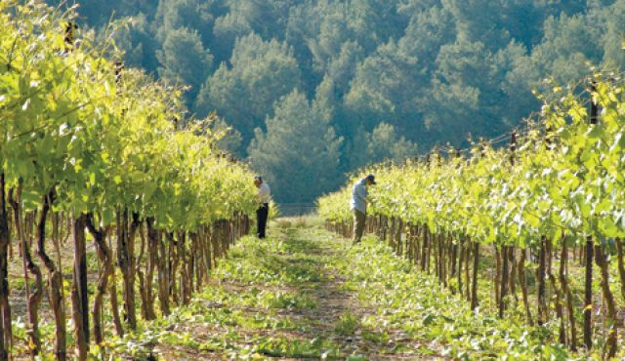
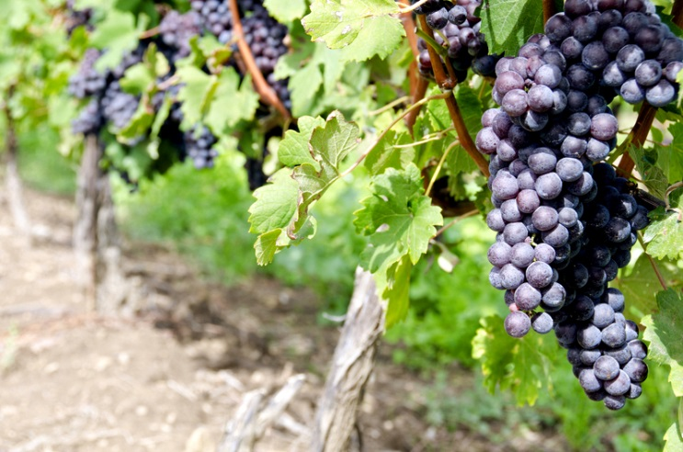
Kanat: insured branches
Other | Crops:
Greenhouses Nurseries Fire and Mechanical Malfunctions Damage Revenue | E.g: Avocado Olive Oil Wine Grapes
 | Livestock

Slide 22
Kanat: Premium distribution (2015)

Slide 23
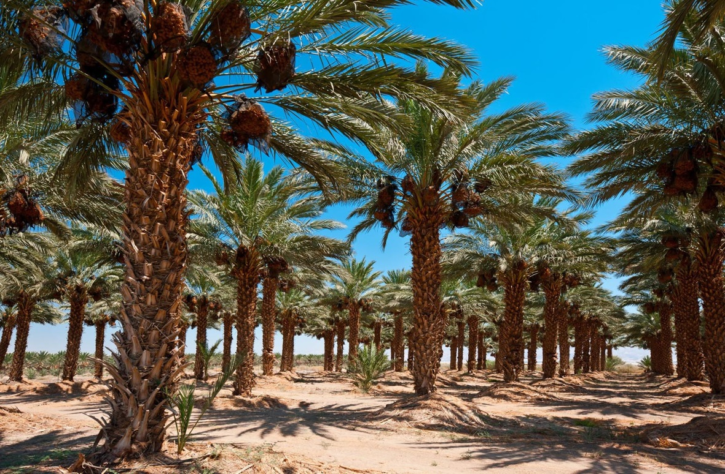
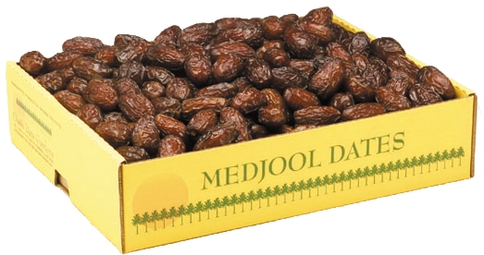
KANAT: Ongoing case
CA 54586-06-18 Kibbutz Eilot v. KANAT
Whether damage to the Majhoul dates was severe or light?

Slide 24
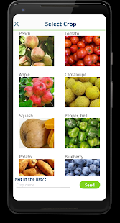
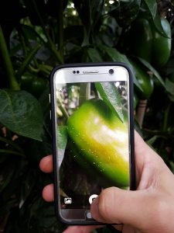
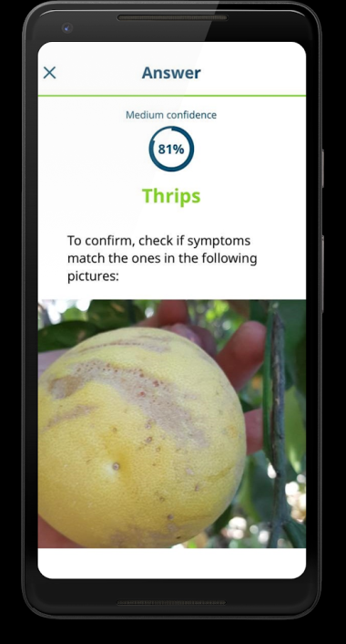
Technology in the aid of agriculture
Index Insurance initiatives for smallholder farmers
Blockchain “smart contract” Crop Insurance
Agrio: Artificial intelligence identifying plant diseases

Slide 25
Thank you! Merci!
AIDA Morocco
Conference,
Marrakech
23 - 25 April 2019

